Slide 1
Secure Data Hiding in Image Using Steganography
CAPSTONE PROJECT
Presented By:
Student Name : PALANISAMY M
College Name & Department : LOYOLA COLLEGE & CS DEPT

Slide 2
OUTLINE
Problem Statement
Technology used
Wow factor
End users
Result
Conclusion
Git-hub Link
Future scope

Slide 3
Problem Statement
"In an era of increasing cyber threats, sensitive data transmission lacks secure, discreet methods. Traditional encryption is detectable, risking interception. This project addresses the need for a covert, user-friendly solution to hide data within images."

Slide 4
Technology used
Libraries:
OpenCV (cv2) - Image processing
NumPy - Array manipulation
Pillow (PIL) - Image handling
Tkinter - GUI development
Platform:
Python 3.8+

Slide 5
Wow factors
Unique Features:
Intuitive GUI for seamless user experience
Password-protected encoding/decoding
Real-time image preview during processing
Lightweight and cross-platform
"Stands out with its blend of accessibility and security."

Slide 6
End users
Cybersecurity enthusiasts
Individuals sharing sensitive data
Organizations needing discreet communication
Students and researchers in data security

Slide 7
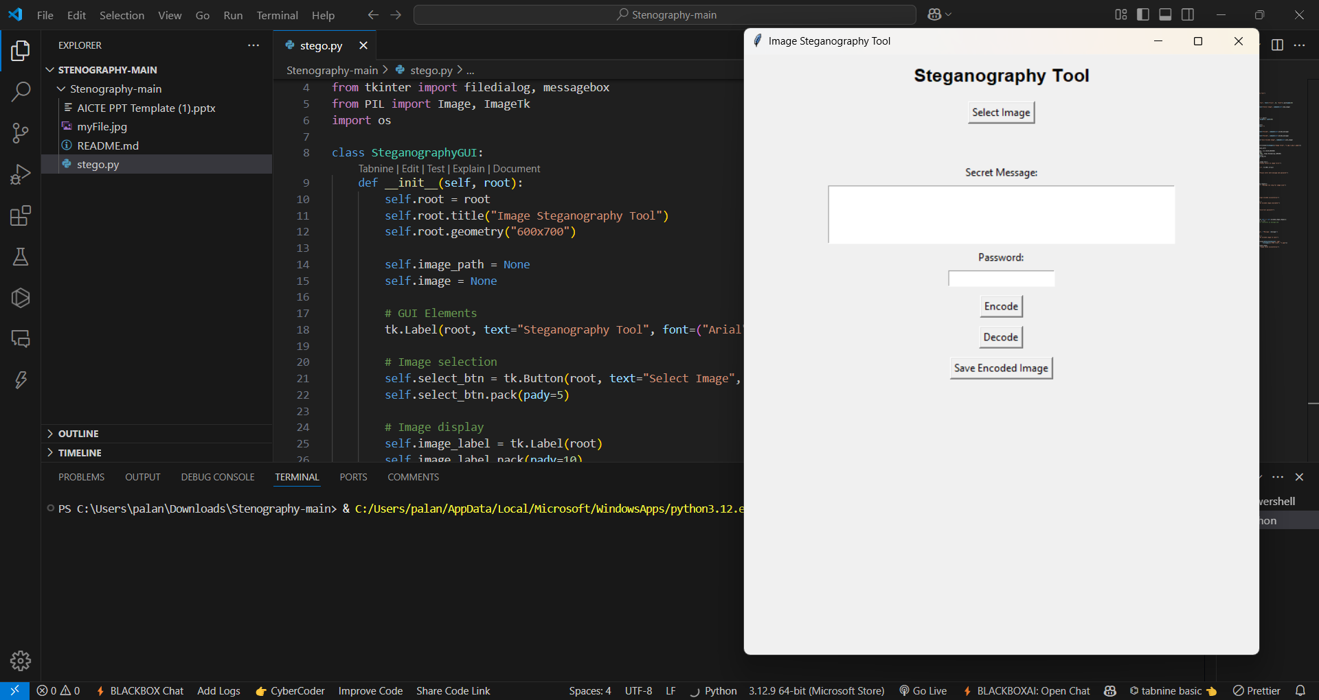
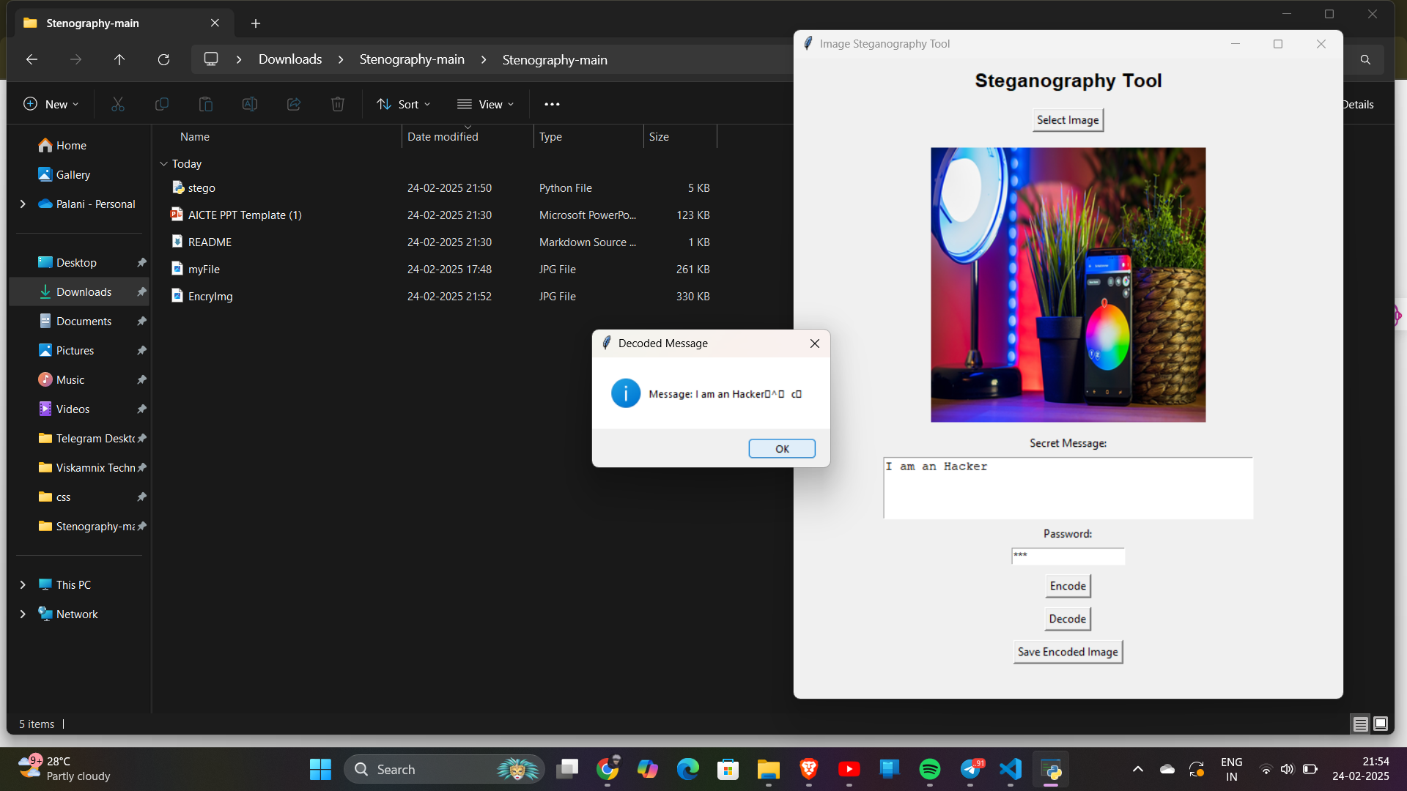
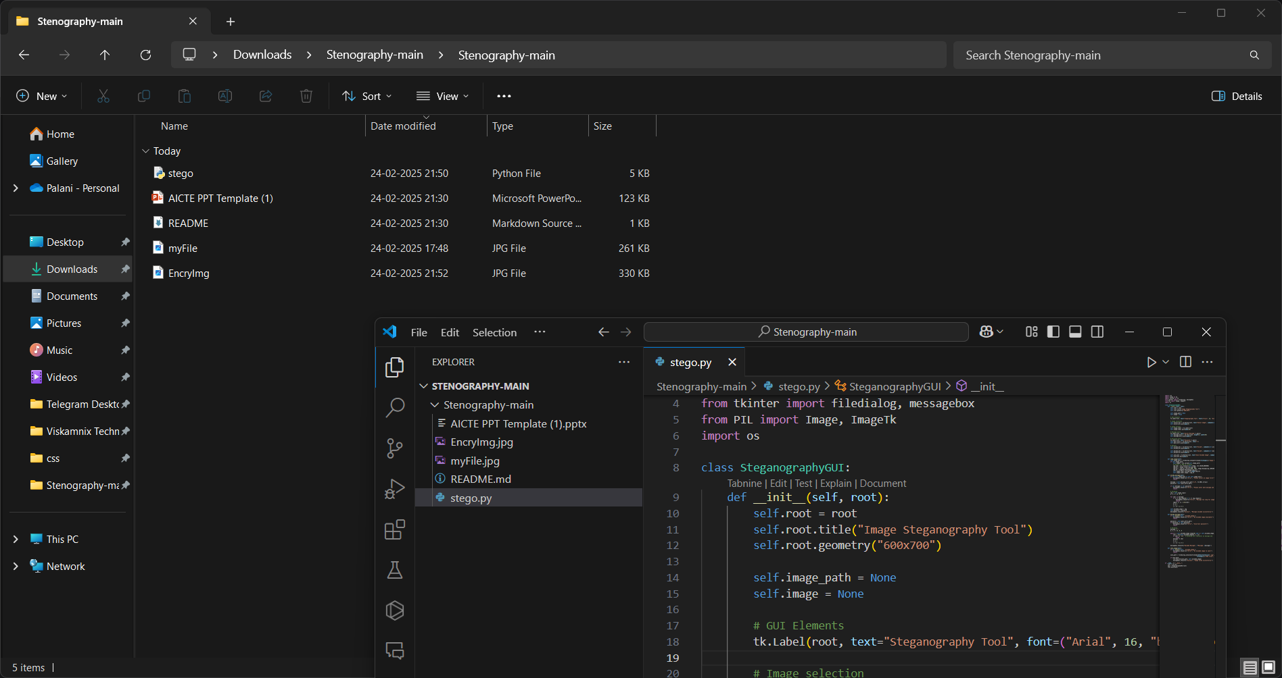
Results

Slide 8
Conclusion
"This project successfully delivers a covert data-hiding solution using steganography, addressing the need for discreet communication. Its user-friendly GUI and password security make it practical and effective for real-world use."

Slide 9
GitHub Link
https://github.com/Palani8147/steganography-project.git

Slide 10
Future scope(optional)
Integrate AES encryption for enhanced security
Support larger messages via compression
Expand to multiple image formats (e.g., BMP, GIF)
Develop a mobile application version

Slide 11
THANK YOU

